Slide 1
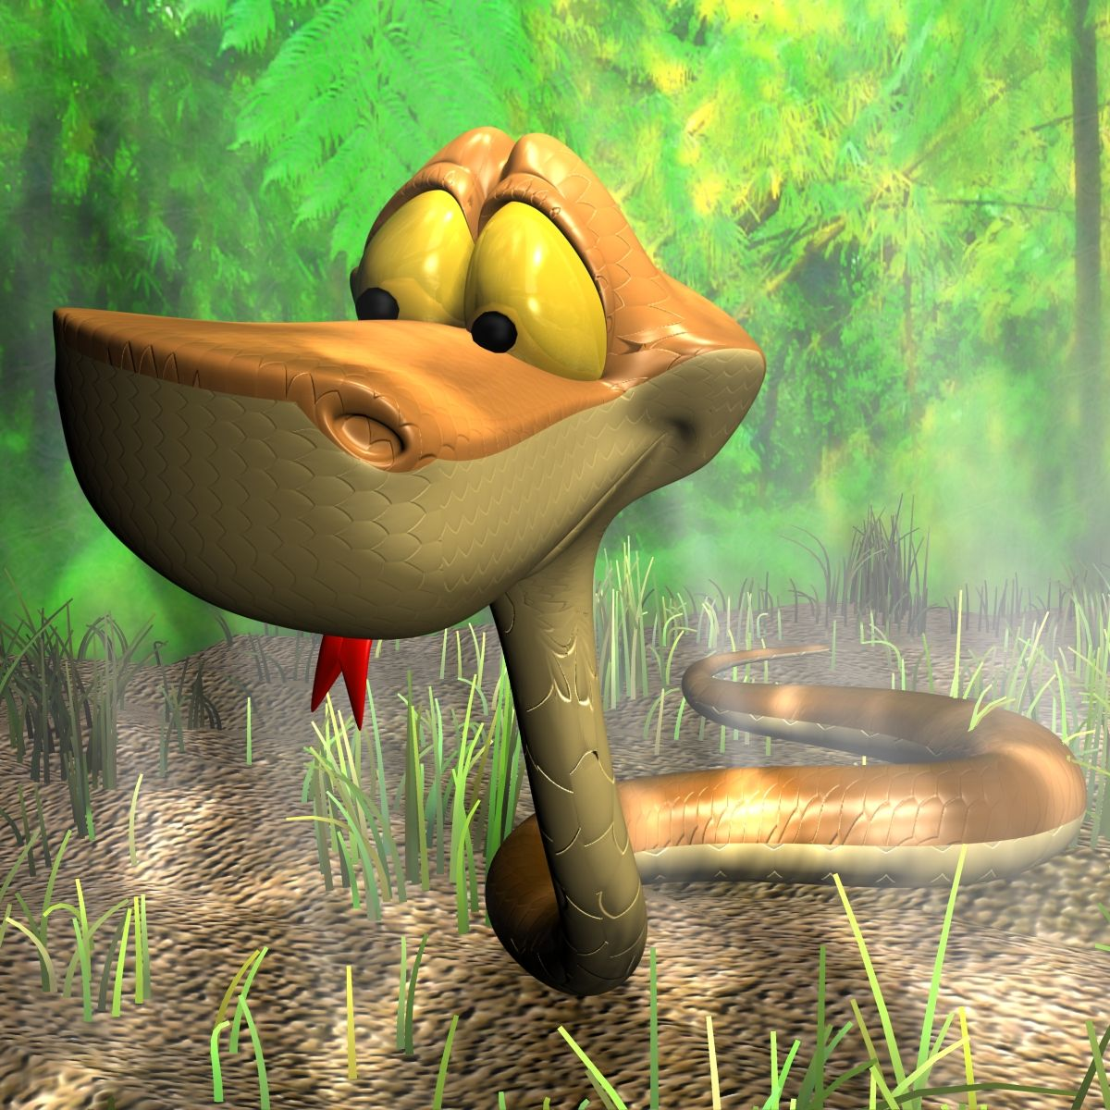
Snake Game

Slide 2

Student Information
Name : Navnath Awate
Roll number : 23092003
Name : Rutuja Birajdar
Roll number : 2309200
Name : Shubham Nanhe
Roll Number : 23092015
Name : Srushti Naik
Roll number : 23092014

Slide 3
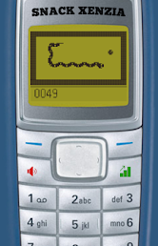
Brief Introduction
The Snake genre began with the 1976 arcade video game Blockade^{[2][3]} developed and published by Gremlin Industries.^{[4]} It was cloned as Bigfoot Bonkers the same year. In 1977, Atari, Inc. released two Blockade-inspired titles: the arcade game Dominos and Atari VCS game Surround

Slide 4
The Hidden Benefits Of Snake Game
The classic game is infamous for using your own success against you when you become so long that you get in your own way. Whilst many games and activities can teach your child about vital life skills, there are not many that would educate on long term strategic planning.
As many parents will know, it can be extremely frustrating to reach such a high level and then lose as you crash into your own tail. The game requires patience in order to grow and a cool head once you inevitably lose. These are all valuable skills to learn early on in a child’s life that will benefit them in later years.
Snake is a tool that can be used as an educational helping hand. One of the important parts of learning is that you will never get something right the first time. Snake teaches children that practice makes perfect when it comes to learning new skills.

Slide 5
Snake Code in C++
Snake is a classic game that includes a growing line represented as a snake that can consume items, change direction, and grow in length. As the snake grows larger in length, the difficulty of the game grows.
The player controls the direction of the snake using the arrow keys as it continuously moves over a board. the goal is to eat food, which makes the snake bigger. If the snake hits the wall or itself, then it dies and the game ends.
In this article, we will create a snake game using a C++ program.

Slide 6
Rules to Play Snake Game
Don’t hit a wall and don’t bite your own tail.
Crashing into a wall or your tail will end the game immediately.
10 points will be added to the player’s score for eating the fruit (#).
The player’s total score is calculated based on the number of fruits the snake consumed.
The length of the snake will be increased after eating the fruits.

Slide 7
Objectives
To create a single-player game.
The snake will be represented with @.
The fruit is to be represented with “X”.
The snake can move in any of the four directions as per the player’s control.
As the snake eats the fruit, the score increases.
The game ends as soon as the snake touches the boundary.
When the game ends, ‘Dead’ gets displayed on the screen.

Slide 8
Requirements
To run this snake game using C++, you must have installed IDE for running and compiling the C++ source code. We recommend Dev C++ or Code Blocks for a better experience.
Refer to the links below to download the Dev C++ or Code Blocks IDE.
https://sourceforge.net/projects/embarcadero-devcpp/
https://sourceforge.net/projects/codeblocks/

Slide 9
Steps to Write a Snake Game
By following these steps, you will be able to create a fully functional snake game in C++ which can be played in the console using the keyboard.

Slide 10
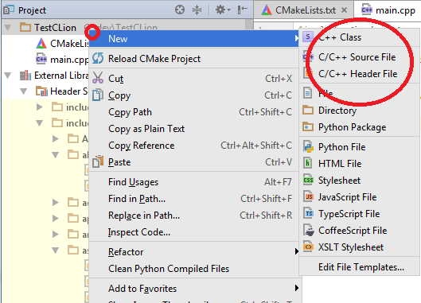
Step 1
Setting Up the project
Create a new C++ source
file (.cpp) in your desired directory.

Slide 11
Step 2
Including Necessary Libraries
We need 4 different libraries that are:
#include <iostream>
#include <windows.h>
#include <conio.h>
#include <cstdlib>
Iostream : Standard Input and Output Library of C++..
windows.h : Windows API Library.
conio.h : Non-Standard Library that contains console commands.
Cstdlib : Contains a superset of the traditional C functions, macros, and datatypes

Slide 12
Step 3
Defining Global Variables for the Game
We have to specify some global game variables that we need to be accessible to all the functions. These are:
// height and width of the boundary
const int width = 80;
const int height = 20;
// Snake head coordinates of snake (x-axis, y-axis)
int x, y;
// Food coordinates
int fruitCordX, fruitCordY;
// variable to store the score of he player
int playerScore;
// Array to store the coordinates of snake tail (x-axis,
// y-axis)
int snakeTailX[100], snakeTailY[100];
// variable to store the length of the sanke's tail
int snakeTailLen;
// for storing snake's moving snakesDirection
enum snakesDirection { STOP = 0, LEFT, RIGHT, UP, DOWN };
// snakesDirection variable
snakesDirection sDir;
// boolean variable for checking game is over or not
bool isGameOver;

Slide 13
Step 4
void GameInit()
{
isGameOver = false;
sDir = STOP;
x = width / 2;
y = height / 2;
fruitCordX = rand() % width;
fruitCordY = rand() % height;
playerScore = 0;
}
Initializing the Game
Create a function named GameInit() of void type for initializing the game variables

Slide 14
Step 5
Creating Game Board cum Game Rendering Function
Create a function named GameRender() of void type for creating the game board and rendering the game whenever needed in the console.

Slide 15
// Function for creating the game board & rendering
void GameRender(string playerName)
{
system("cls"); // Clear the console
// Creating top walls with '-'
for (int i = 0; i < width + 2; i++)
cout << "-";
cout << endl;
for (int i = 0; i < height; i++) {
for (int j = 0; j <= width; j++) {
// Creating side walls with '|'
if (j == 0 || j == width)
cout << "|";
// Creating snake's head with 'O'
if (i == y && j == x)
cout << "O";
// Creating the sanke's food with '#'
else if (i == fruitCordY && j == fruitCordX)
cout << "#";
// Creating snake's head with 'O'
else {
bool prTail = false;
for (int k = 0; k < snakeTailLen; k++) {
if (snakeTailX[k] == j
&& snakeTailY[k] == i) {
cout << "o";
prTail = true;
}
}
if (!prTail)
cout << " ";
}
}
cout << endl;
} // Creating bottom walls with '-'
for (int i = 0; i < width + 2; i++)
cout << "-";
cout << endl;
// Display player's score
cout << playerName << "'s Score: " << playerScore
<< endl;
}

Slide 16
Step 6
Updating the Game State
Create a function named UpdateGame() of void type for updatig the game state after each move.

Slide 17
// Function for updating the game state
void UpdateGame()
{
int prevX = snakeTailX[0];
int prevY = snakeTailY[0];
int prev2X, prev2Y;
snakeTailX[0] = x;
snakeTailY[0] = y;
for (int i = 1; i < snakeTailLen; i++) {
prev2X = snakeTailX[i];
prev2Y = snakeTailY[i];
snakeTailX[i] = prevX;
snakeTailY[i] = prevY;
prevX = prev2X;
prevY = prev2Y;
}
switch (sDir) {
case LEFT:
x--;
break;
case RIGHT:
x++;
break;
case UP:
y--;
break;
case DOWN:
y++;
break;
}
// Checks for snake's collision with the wall (|)
if (x >= width || x < 0 || y >= height || y < 0)
isGameOver = true;
// Checks for collision with the tail (o)
for (int i = 0; i < snakeTailLen; i++) {
if (snakeTailX[i] == x && snakeTailY[i] == y)
isGameOver = true;
}
// Checks for snake's collision with the food (#)
if (x == fruitCordX && y == fruitCordY) {
playerScore += 10;
fruitCordX = rand() % width;
fruitCordY = rand() % height;
snakeTailLen++;
}
}

Slide 18
Step 7
Setting the Game Difficulty
Create a function named SetDifficulty() of int type for setting up the game difficulty(returns a int variable ‘dfc’).
// Function to set the game difficulty level
int SetDifficulty()
{
int dfc, choice;
cout << "\nSET DIFFICULTY\n1: Easy\n2: Medium\n3: hard "
"\nNOTE: if not chosen or pressed any other "
"key, the difficulty will be automatically set "
"to medium\nChoose difficulty level: ";
cin >> choice;
switch (choice) {
case '1':
dfc = 50;
break;
case '2':
dfc = 100;
break;
case '3':
dfc = 150;
break;
default:
dfc = 100;
}
return dfc;
}

Slide 19
Step 8
Handling User Input
Create a function named UserInput() of void type for getting the user input for playing the game
// Function to handle user UserInput
void UserInput()
{
// Checks if a key is pressed or not
if (_kbhit()) {
// Getting the pressed key
switch (_getch()) {
case 'a':
sDir = LEFT;
break;
case 'd':
sDir = RIGHT;
break;
case 'w':
sDir = UP;
break;
case 's':
sDir = DOWN;
break;
case 'x':
isGameOver = true;
break;
}
}
}

Slide 20
Note
1._kbhit() function checks the console for a recent keystroke. If the function returns a nonzero value, a keystroke is waiting in the buffer. The program can then call _getch() or _getche() to get the keystroke.
2. getch()is a nonstandard function and is present in file which is mostly used by. It is not part of the C standard library or ISO C, nor is it defined by POSIX

Slide 21
Step 9
Creating Main Function
Create a loop in the main() function to continuously update the game state, render the game, and handle user input.
/ Main function / game looping function
int main()
{
string playerName;
cout << "enter your name: ";
cin >> playerName;
int dfc = SetDifficulty();
GameInit();
while (!isGameOver) {
GameRender(playerName);
UserInput();
UpdateGame();
// creating a delay for according to the chosen
// difficulty
Sleep(dfc);
}
return 0;
}

Slide 22
Conclusion
We have successfully created a Snake game using C++. We Hope the code explanation was precise and clear. Now you can try this source code on your own and have fun playing the game.

